Slide 1

Learning Data Science in K-12 Education
Data Science 4 Everyone
The University of Chicago
Summer 2023

Slide 2
Critical Mission:
Catalyze the adoption of data science & data literacy as an integrated component
of K-12 education
by 2030.

Slide 3
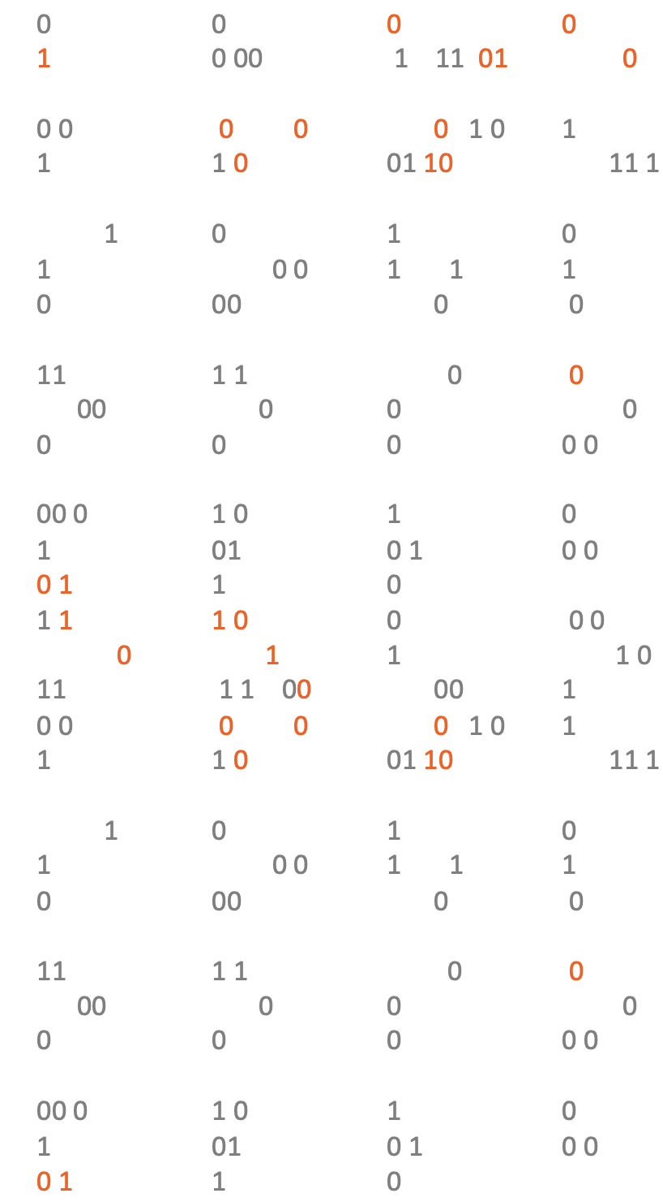

National Progress
Overview & Movement Strategy
Summer 2023

Slide 4

Why focus on data?
Why integrate in K-12?
Improve personal financial, health, and civic decision-making in the data deluge of our modern information economy
Mitigate the digital divide and create confident users of emerging technologies (AI, blockchain, etc.) at a population level
Mitigate workforce automation effects as tasks become increasingly computer-assisted with data inputs and outputs¹
1: (McKinsey, 2019) projects higher rates of displacement for Black American workers
Fix K-12 math education challenged by low student motivation and high school graduation barriers.
Prepare for today’s college degrees where 138 college disciplines now require data analytics as fields adopt computational tools²
Modernize alternative vocational routes with early exposure to low-cost digital training, credentials, and apprenticeships straight from high school
2: American Statistical Association (ASA), 2017.

Slide 5
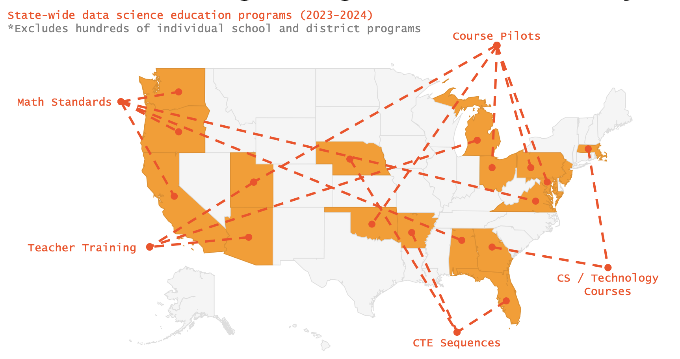
K-12 Data Science is growing:

Slide 6
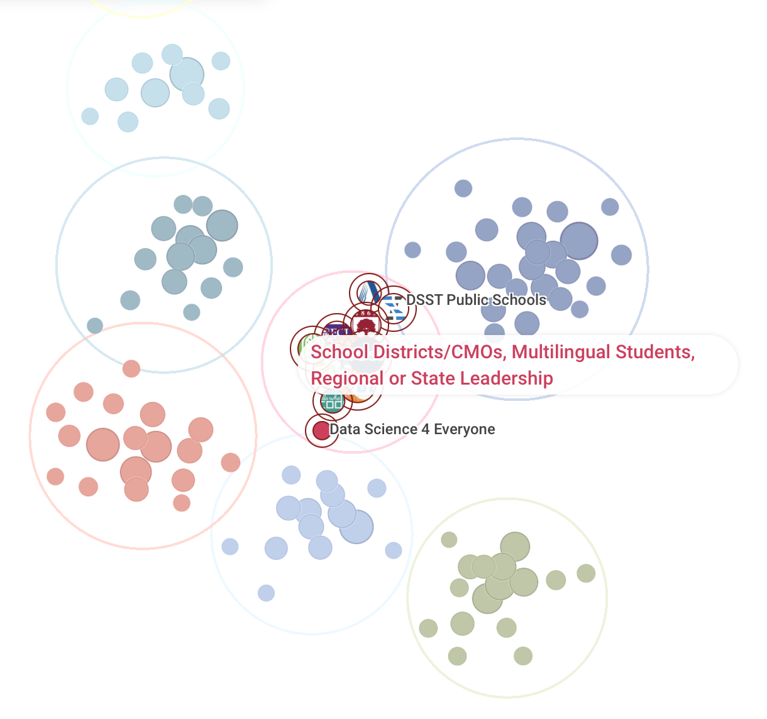
The K-12 system is complex, decentralized, and over-burdened. We try to help connect people to each other and share what we’ve learned.
How did we do it? Field-building.
System coordination.
Centralizing information.
Technical assistance.
Talent-placement.
Policy support.
Case-making.
Gap-filling.
Beyond 100K Network Snapshot, 2023

Slide 7
6.1% of schools offer
data science coursework (out of 26,000 U.S. high schools) – estimated as of 2022-23 school year
3.6% of students have enrolled
in data science coursework (out of 15.1 million high school students, with 3.75 million per grade)
0.9% of teachers have been trained
in basic data science pedagogy and software tools (out of 246,000 high school math teachers)
Where we are:
Where we need to go:
All schools offer, especially rural and majority-poverty (Title I)
All students participate K through 12, via integrated coursework in existing school subjects that everyone takes.
All relevant teachers trained, with a focus on mathematics, social studies, and science subjects.

Slide 8
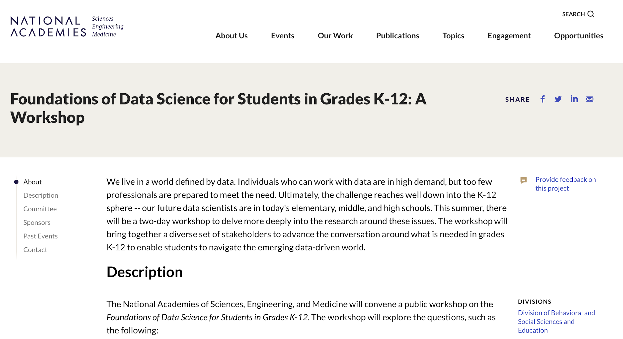
K-12 data science is “new,” but with a history:
2013 – NSF grants fund curriculum, software research
2017 – Data Science Education Technology Conference (Concord Consortium)
2019 – IDSSP Framework Released
DS4E is created @ UChicago RISC
2020 – GAISE II Framework Released
2020 – National K-12 Summit at Stanford University
2021 – K-12 Technical Working Group (IES)
2022 – Foundations of Data Science Workshop (National Academies Workshop)

Slide 9
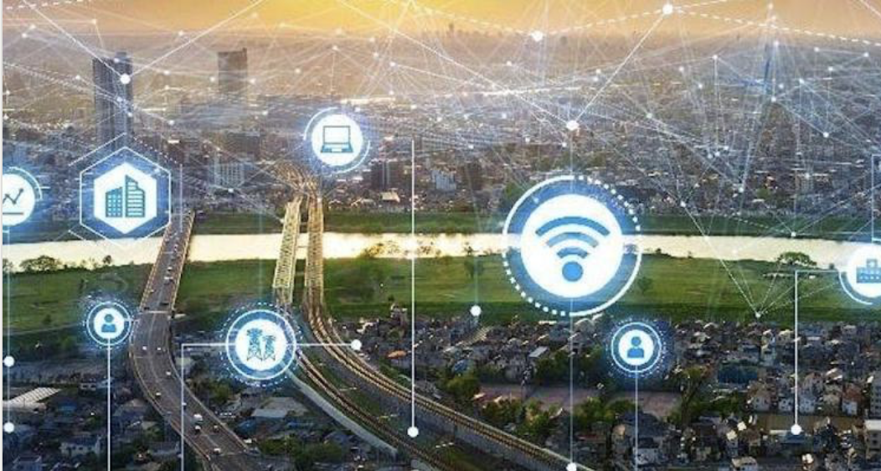
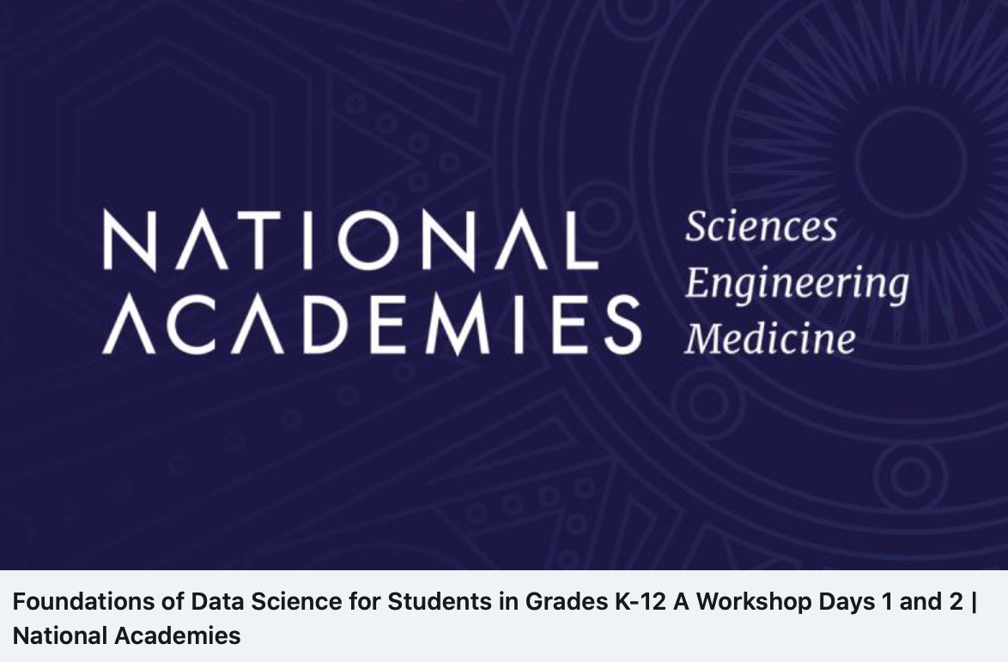
Data Science in The Field:

Slide 10
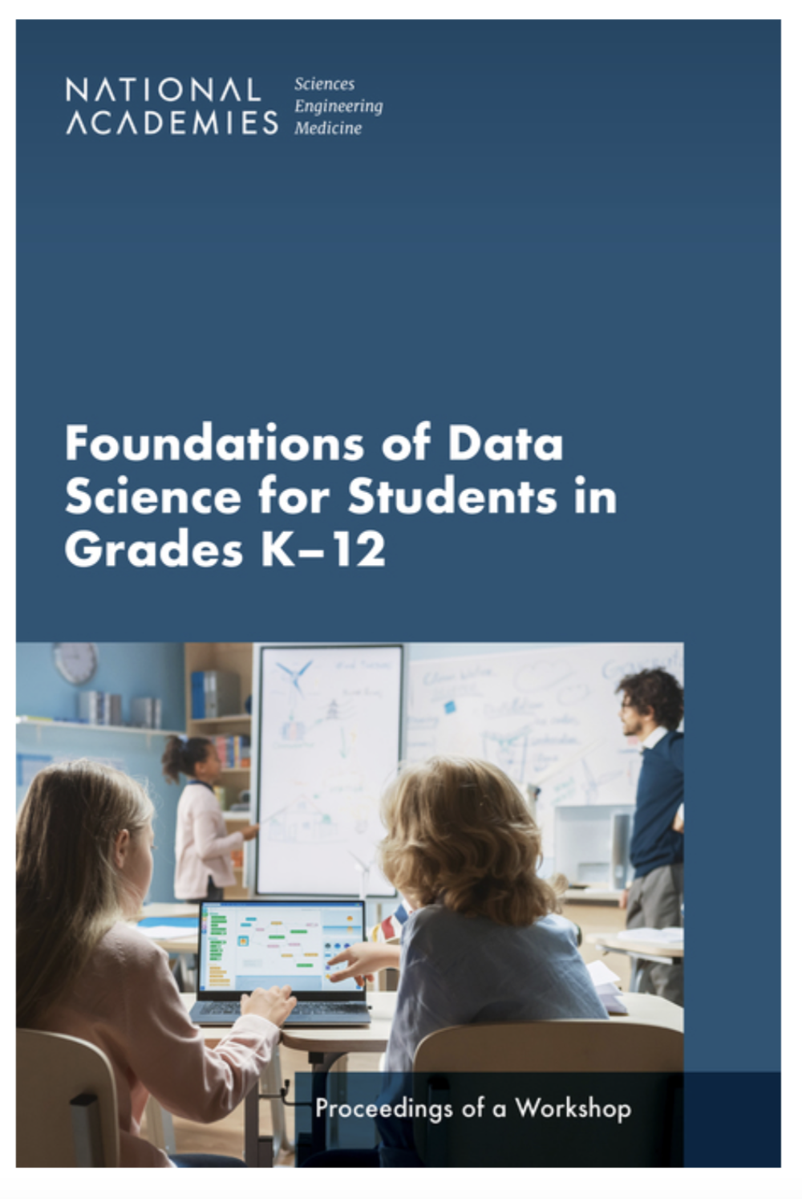
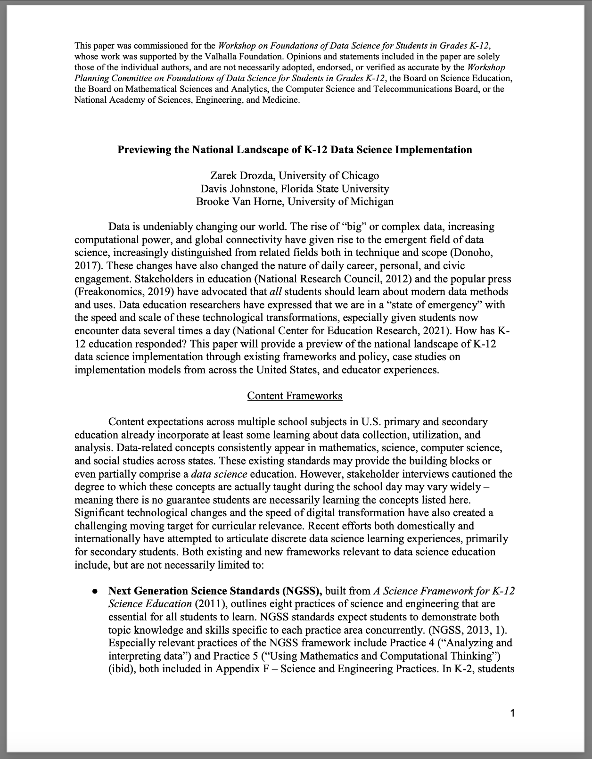
March 2023
New
Sep 2022

Slide 11
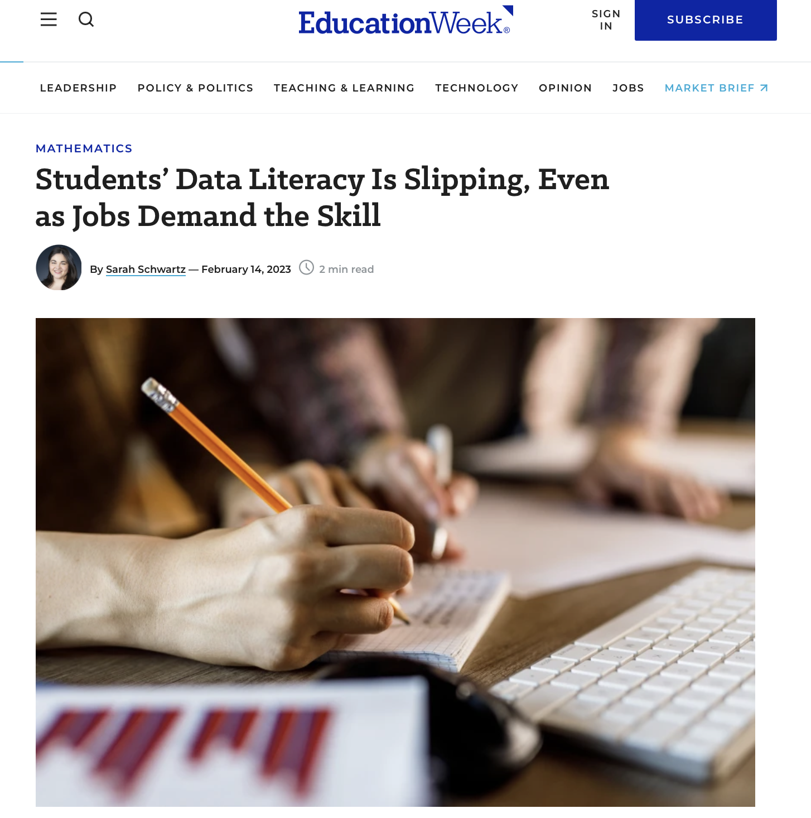
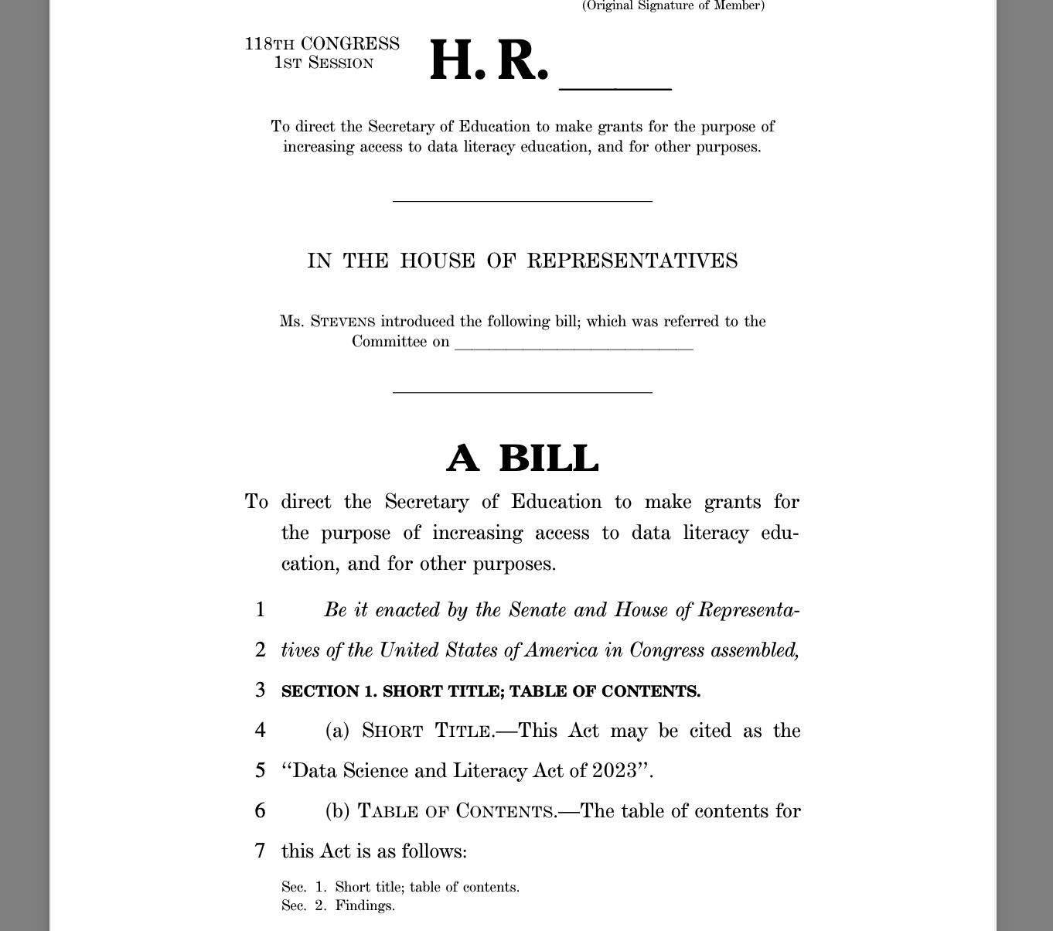
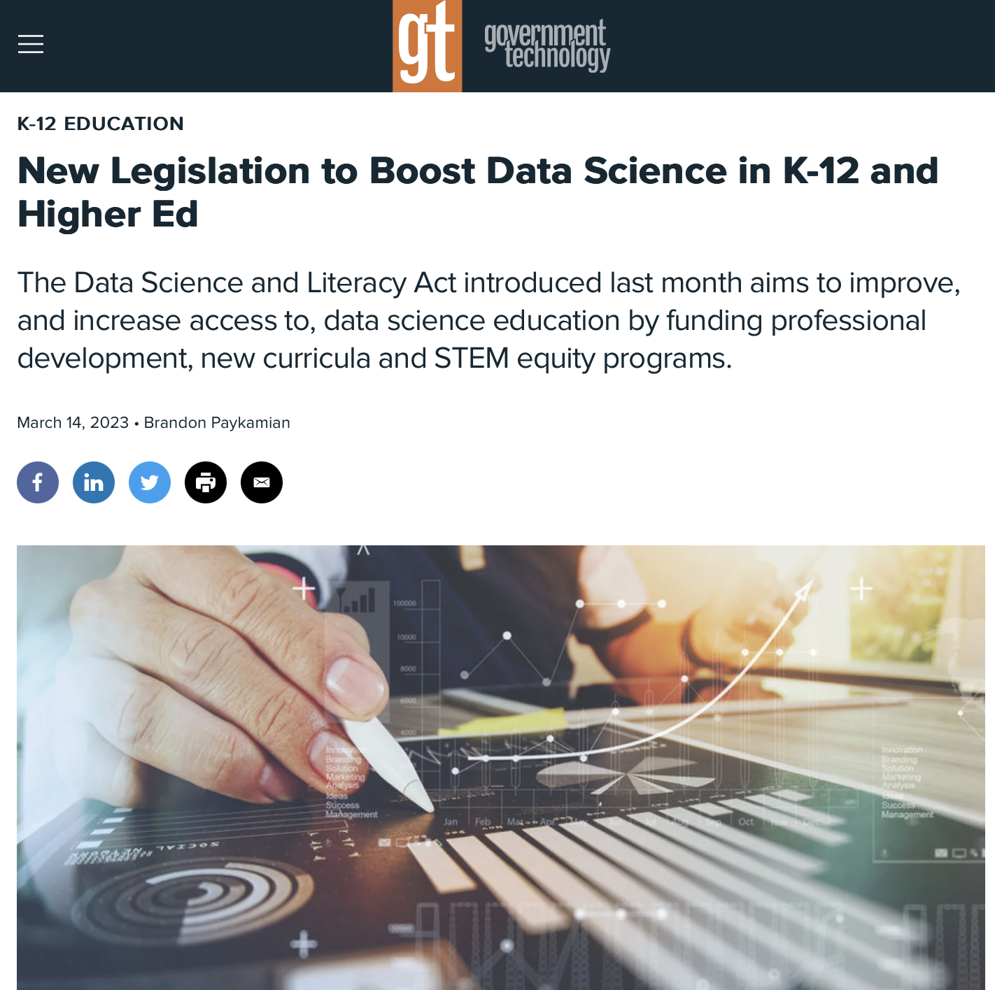
Data Science & Literacy Act of 2023

Slide 12


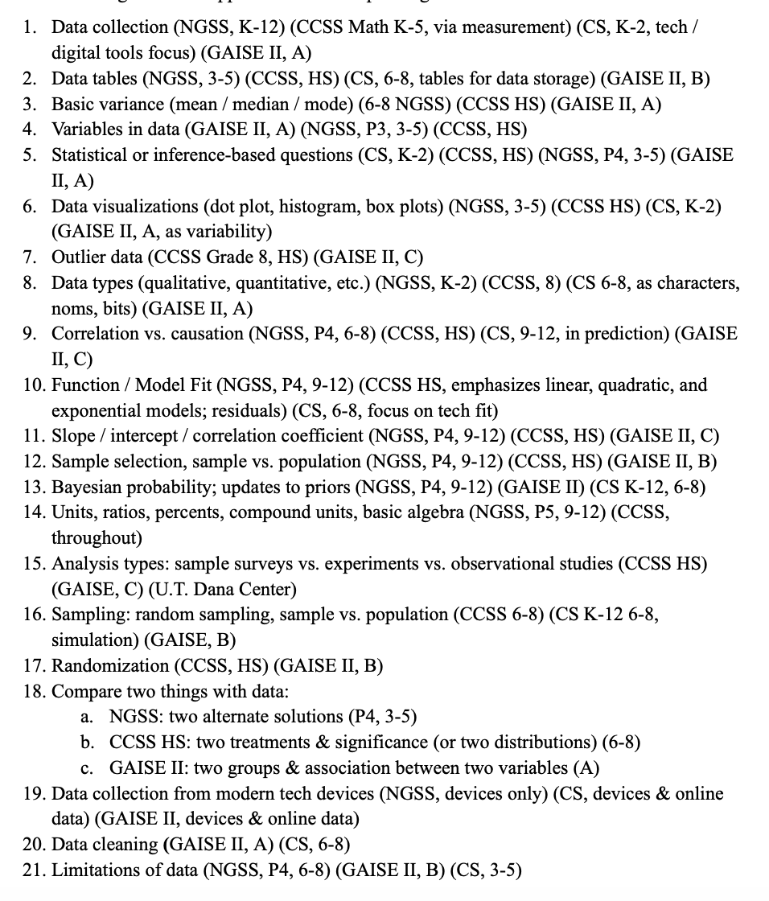
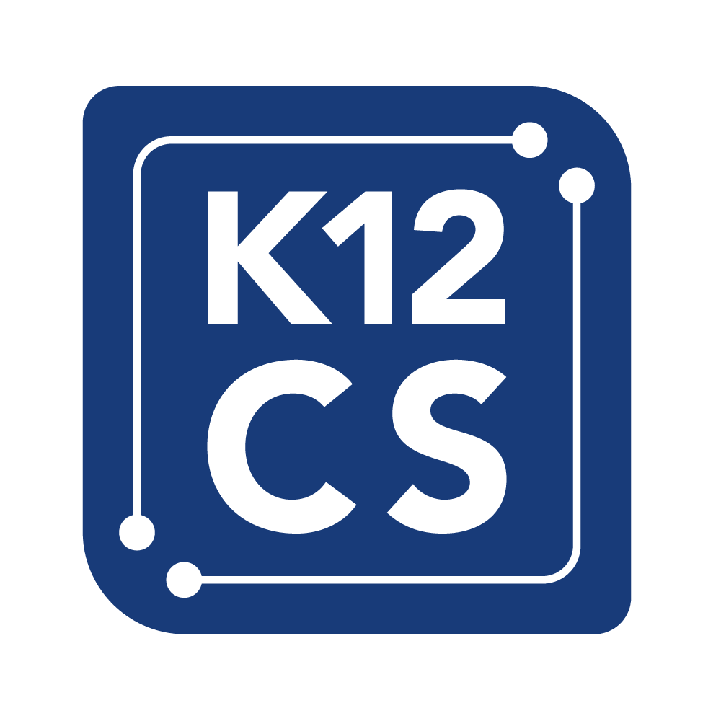
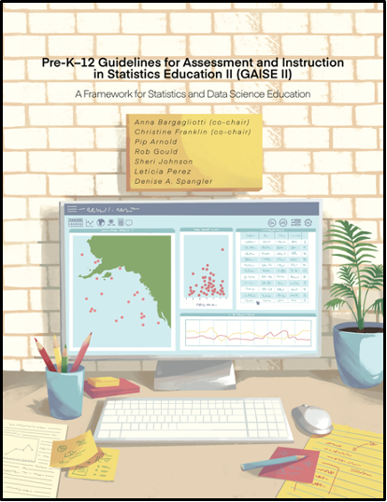
National context: data edu. in existing standards
Notes:
We also wanted to put this in the broader context of existing K-12 frameworks guiding content across existing school subjects
We reviewed existing cross-state standards in:
Math
Statistics
Science
Computer Science
Across subjects, there is already a decent dosage of standards that, at least on paper, would make you think we already teach students about data pretty regularly. However, the reality doesn’t really feel like that. So we asked some teachers to give us their official opinion to submit to the National Academies of Engineering & Medicine

Slide 13
Possibly not enough? Teachers told us why:
Not actually taught: existing data standards often cut, brushed-over, or in the background;
Low teacher confidence
Perception of assessments not prioritizing
Technology is missing: students enjoy authentic technology, but few and far between;
DS programs have found students (and teachers!) enjoy the innovation
K-12 standards treatment of tech is skimpy: brief mentions of spreadsheets, calculators, hand-held sensors
Data ethics is missing: existing standards only highlight data privacy;
Little mention of bias in datasets, ML models, and the resulting algorithms
Little mention of “fact-based authority” of data and ways it can be manipulated
Methods are too simplistic: we need modern methods and processes > finite list of skills

Slide 14






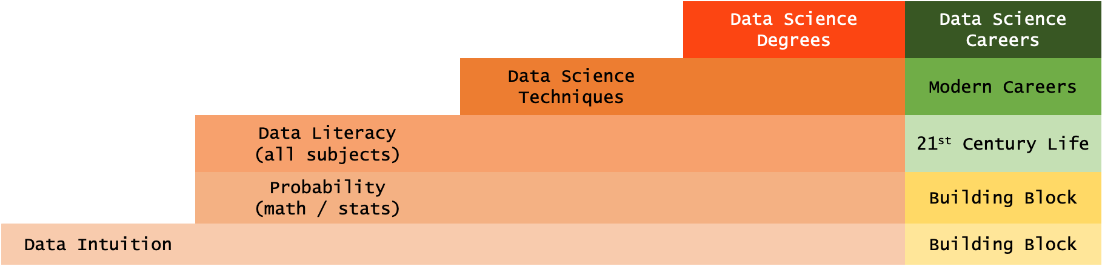
Building modern data education:
 |  |  | Data Science Degrees | Data Science Careers
 |  | Data Science Techniques |  | Modern Careers
 | Data Literacy (all subjects) |  |  | 21st Century Life
 | Probability (math / stats) |  |  | Building Block
Data Intuition |  |  |  | Building Block
Elementary (K-5)
Middle School
(6-8)
High School
(9-12)
College
(2-/4-Year)
Real-World
(Life)

Slide 15


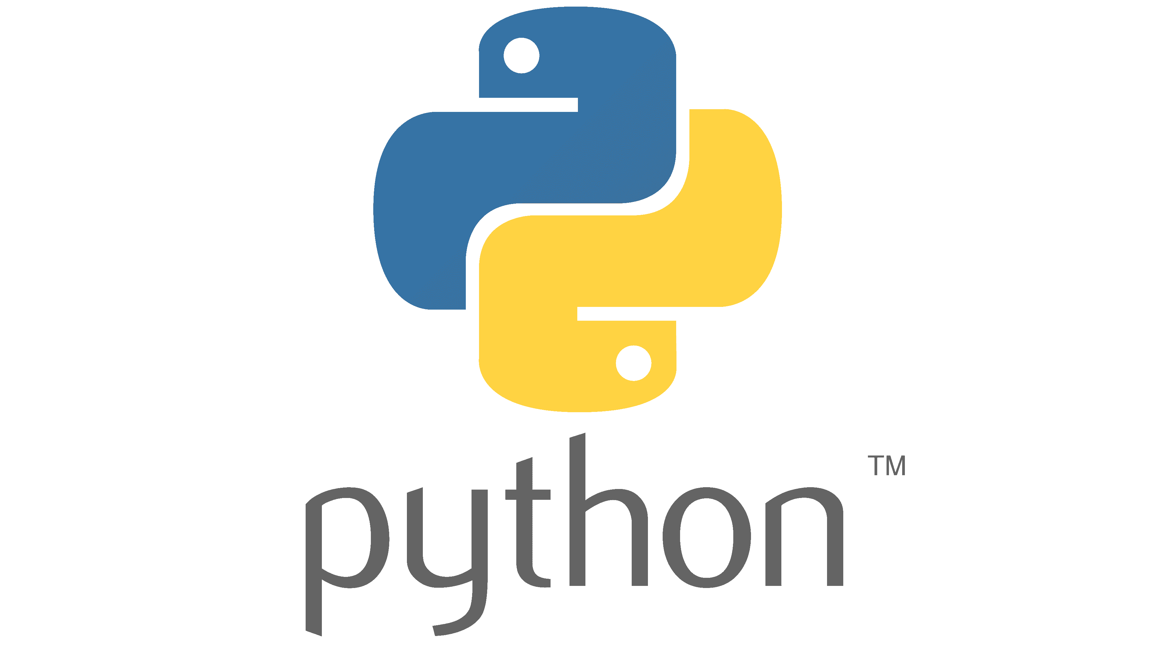

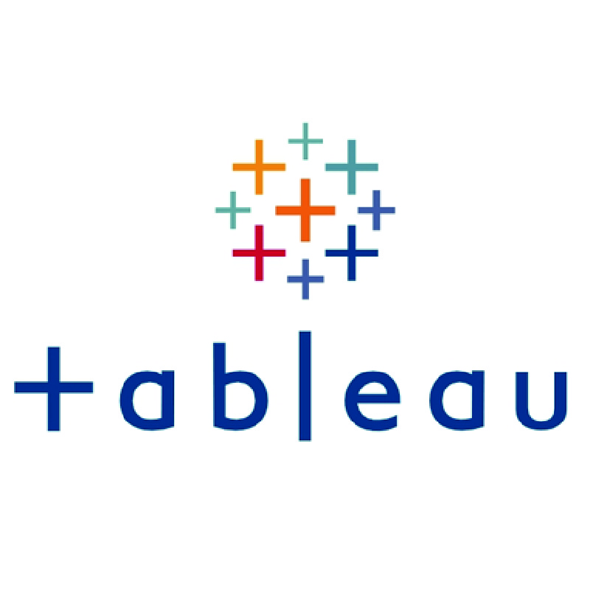

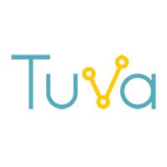




With relevant tech tools:
 |  |  | Multiple Software | Data Science Goals
 |  | Intro to Data Analytics Software |  | Data-Related Careers
 | Spreadsheets / Everyday Software |  |  | 21st Century Skills & Jobs
Education-Specific Software |  |  |  | Building Block
Elementary (K-5)
Middle School
(6-8)
High School
(9-12)
College
(2-/4-Year)
Real-World
(Life)

Slide 16
What convinced you to take this on?

Slide 17
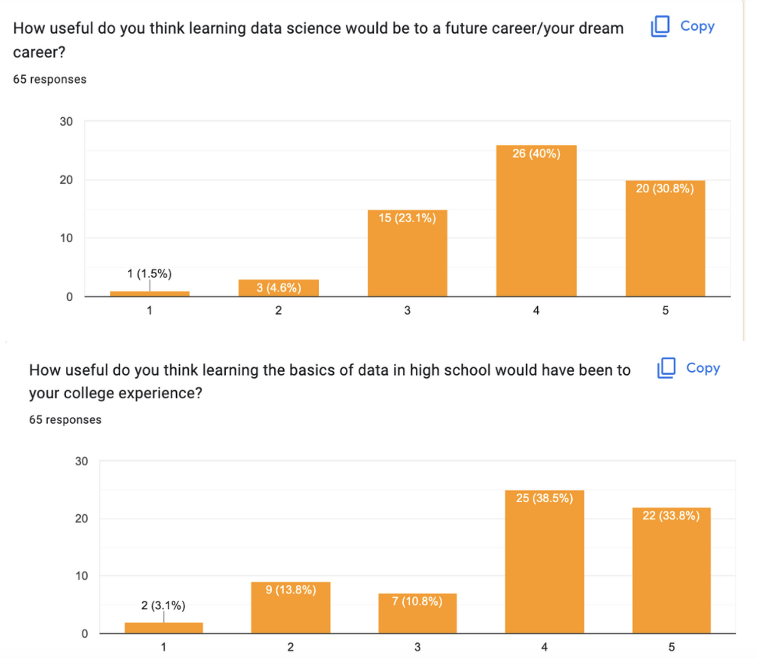

Slide 18
What convinced you to take this on?

Slide 19



Summer learning extensions:
#1
bit.ly/3NT7vXn
MH Office Hours #2

Slide 20
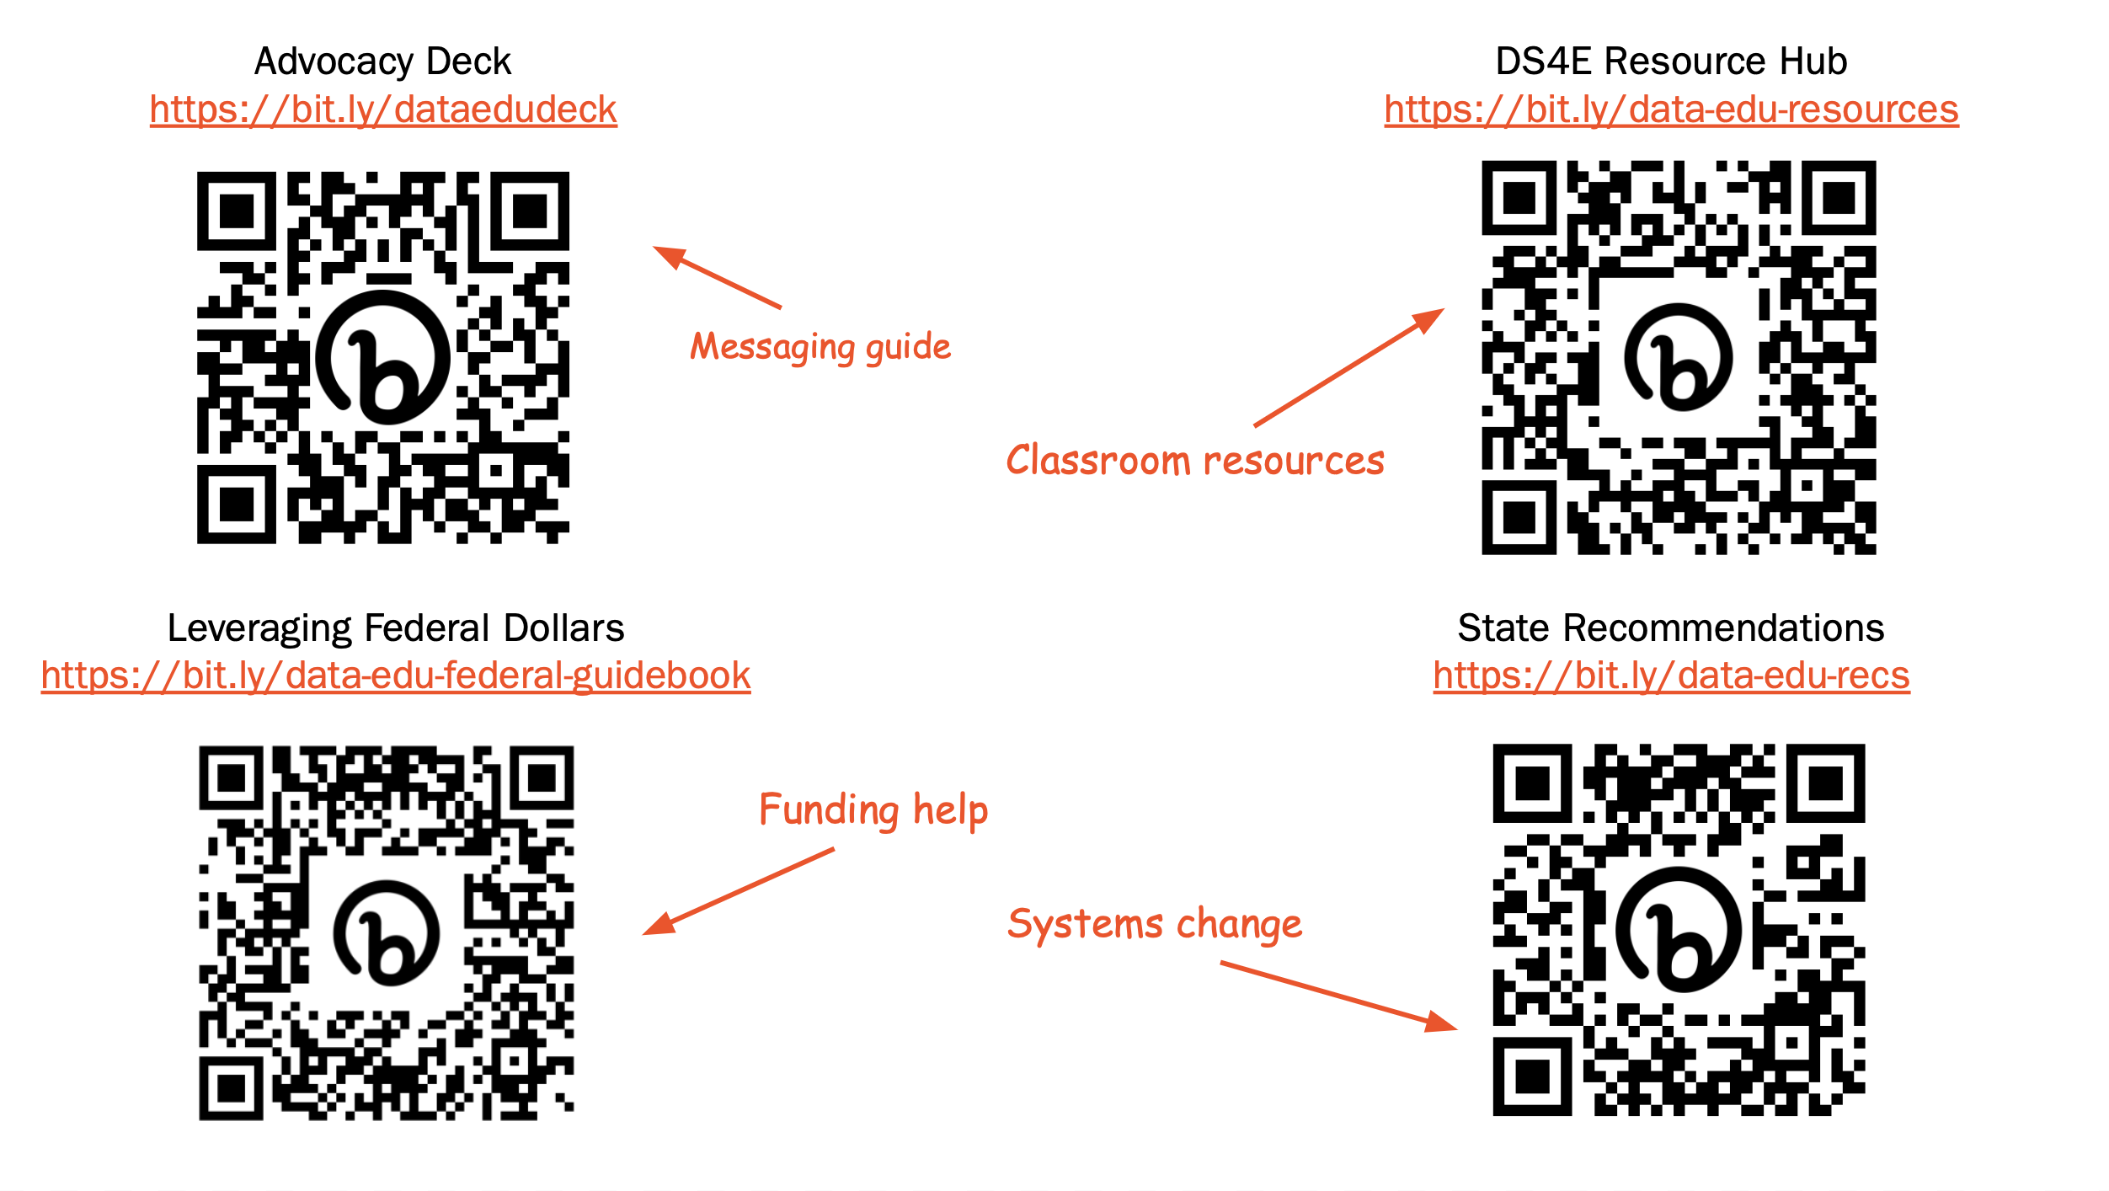

Slide 21
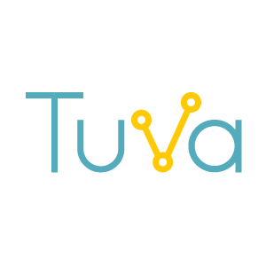
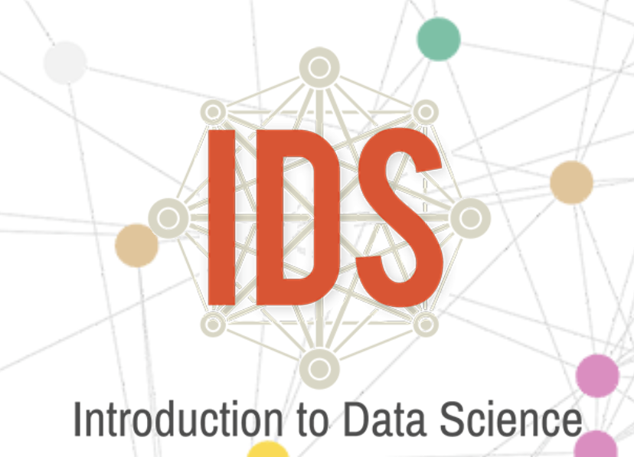
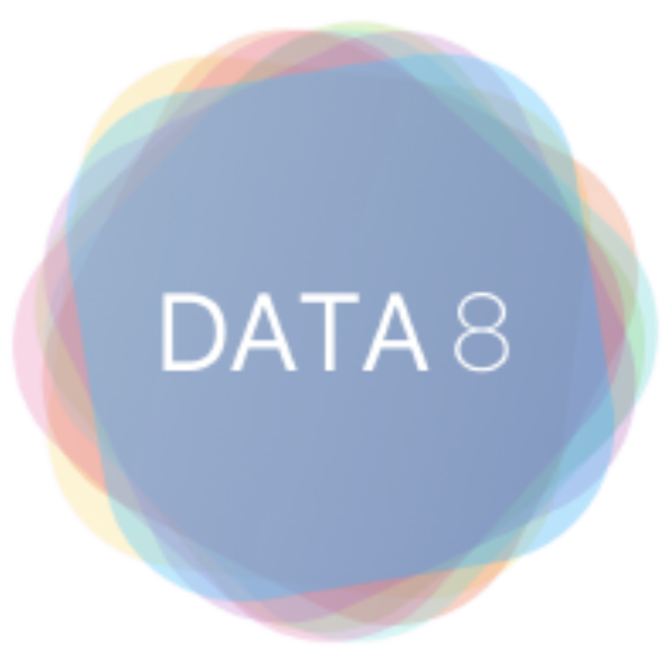





One-Year
Integrated
Platform

Slide 22






Slide 23

Keep us updated on your progress!
bit.ly/ds-program-share

Slide 24

Q&A
Data Science 4 Everyone
The University of Chicago
bit.ly/ds4e-sign-in
Notes:
bit.ly/ds4e-sign-in

